Slide 1




to
Notes:
Hi everyone! Congrats on your acceptance into UC Davis! This is a monumental achievement, so I hope that you and your family are proud!
As you watch this presentation, there will be audio on every slide, so when the audio is finished, be sure to manually click to the next slide.

Slide 2

WE ARE THE
Languages & Literatures Community
Notes:
If you are watching this presentation, chances are that you are part of the Languages & Literatures community!
Sometimes we just call ourselves “LangLit” for short. Basically, we are a collection of majors and programs at UC Davis focused on the humanities and world languages and cultures!

Slide 3

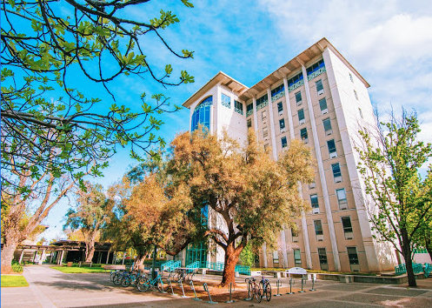
where: sproul hall
Home of Languages & Literatures:
  Chinese & Japanese
  Classics, Latin, & Greek
  Comparative Literature
  French & Italian
  German & Russian
  Religious Studies
  Spanish & Portuguese
  Humanities
  Human Rights
Fun fact: One of the tallest buildings in Davis!
Your major advisors are on the 2nd floor!
Notes:
On campus, we are located at Sproul Hall, which is a short walk away from the Shields Library or the Memorial Union and Quad! Fun fact: At 9 floors high, we are one of the tallest buildings in Davis! Super impressive, I know.
On the right, you’ll see a list of programs within Languages & Literatures, and you probably see your own hopeful major too! Whenever you come by for major advising, you’ll find us on the 2nd floor, so no strenuous stair climbing, which is good. But don’t worry, the building has an elevator too if you ever want to see a bit of Sacramento from the 9th floor conference room!

Slide 4

EAST ASIAN
LANGUAGES AND CULTURES
CHINESE AND JAPANESE MAJORS
Notes:
Now, let’s be more a little more specific: if you are watching this virtual presentation, you probably signed up for UC Davis as a Chinese or Japanese major! Together, we form the East Asian Languages and Cultures department, or EALC for short.

Slide 5
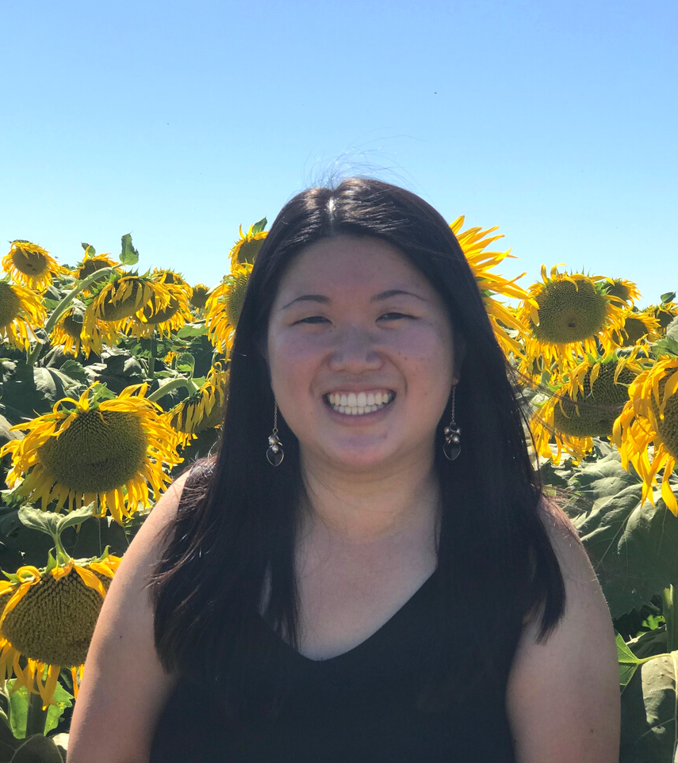



Introductions
LAUREN
You wouldn’t know this but…
I can spin a basketball on any of my right fingers.
I love coffee.
Undergraduate Program Coordinator and Advisor
I'm a UC Davis graduate!
I studied Sociology and Psychology.
lnawong@ucdavis.edu
Notes:
Now, you might be wondering who the heck has been speaking this whole time, so let me introduce myself a little bit! I had a little too much fun with my bitmojis, so apologies in advance.
Anyway, my name is Lauren Wong, and I am the undergraduate program coordinator and advisor for EALC. If you have more questions after this presentation, feel free to reach out to me through my email on the screen.
Some fun facts about me: I can spin a basketball on any of my right fingers, I have an unhealthy coffee addiction, and I am actually a UC Davis graduate myself!

Slide 6

My role as your advisor
I am here to…
Explain Chinese/Japanese major requirements
Collaborate with you on an academic plan
Listen to your questions and experiences
Share opportunities within the department for internships and professional development
Help you hope in yourself during the seasons you can't seem to believe in yourself
Notes:
In terms of my role as your advisor, I am here to explain your major requirements and work with you on developing your academic plan! Beyond the realm of academia, I am here to listen to your questions and experiences, share opportunities for professional development on campus, and help you hope in yourself during challenging times that may come. My door is always open for you, so don’t be afraid to stop by my office in Sproul.

Slide 7

program overview
Check out our website! ealc.ucdavis.edu
Under the "Academics" tab, hover over "Advising" and you will find degree requirements for the Chinese and Japanese majors.
  One of the best language programs in the country!
  Only 40-70 units in each major
perfect for double majors/minors
  Small classes
more professor interaction
  Study abroad!
Notes:
Let’s talk about the EALC program! It would be helpful for you to visit our website, ealc.ucdavis.edu, when you have spare time. Check out the orientation tab for regular updates. Under the “academics” tab, hover over “advising” and you’ll find a page that details the major requirements for Chinese and Japanese majors. This will be helpful when it comes time to register for fall classes in the summer.
Side note: Be on the lookout for emails from the College of Letters & Science about Aggie 101, Aggie Advising, and Aggie Orientation. These are resources that will help you with course registration questions. Be sure to set up a remote advising appointment with your College of Letters & Science advisors over the summer!
Did you know that the Chinese and Japanese programs at UCD are ranked as one of the best language programs in the country?? Beyond language, you’ll get to study so many diverse topics like film, poetry, drama, linguistics, and popular culture in our program. In addition to gaining advanced Chinese and Japanese language skills, you’ll learn a global perspective, critical thinking, written communication, and teamwork skills too – skills that every employer in the career world looks for.
Even more, the Chinese and Japanese majors are only about 40-70 units, meaning the programs are small enough for you to easily double major or minor in another field of your choice at UCD, like International Relations, Design, Economics, and more. Our small courses provide space for meaningful connections to your other classmates and professor. A bit later in the presentation, I will also talk about study abroad opportunities.

Slide 8









what can i do with chinese and japanese??
Anything and everything! Think this way: transferable skills.
growth mindset
public speaking
writing
teamwork
critical thinking
cultural humility
remember...
major career
Notes:
Part of you may be worried: What can I do with a major in Chinese or Japanese?
Well I am here to tell you: anything and everything! You have to think about it in terms of transferable skills. Like I touched on before, there are so many skills you gain through the Chinese and Japanese programs beyond language acquisition.
Growth mindset: It is difficult to learn the nuances of a new language. Majoring in Chinese or Japanese demonstrates self-motivation and reveals an ability to push through challenges and receive constant feedback with a growth mindset. It demonstrates an exceptional level of commitment to law, medical or graduate schools, as well as potential employers.
Public speaking: It's hard enough to speak in front of people in your native tongue, but in a foreign language too?! Chinese and Japanese classes foster confidence through oral presentations and in-class discussions.
Writing: It is so important that you know how to effectively articulate your thoughts in the professional world. Chinese and Japanese literature and culture classes can sharpen your written communication expertise, and the upper division courses work together to develop powerful argumentative skills.
Teamwork: Chinese and Japanese classes are often organized around working in groups or pairs! These classes foster your ability to work with people of different cultural backgrounds—to overcome issues and make decisions together.
Critical thinking: It is crucial that you know how to analyze issues in the world. Chinese and Japanese classes shed light on diverse perspectives and help you evaluate new ideas.
Cultural humility: In an increasingly diverse and yet polarized world, it is important to develop a framework of cultural humility and compassion for people of all backgrounds.
One point I want you to remember is that your major doesn’t equal your career. Always think about what skills you want to sharpen.

Slide 9

language placement
The Chinese and Japanese major programs at UCD will strengthen your language proficiency to near fluency.
Keep in mind: Every student who plans to take Chinese or Japanese language courses will need to take the placement test through the
Davis Language Center: ucdlc.ucdavis.edu.
ealc.ucdavis.edu Under the "Academics" tab, hover over "Language Placement Exam" and you will find more information about the Chinese and Japanese placement exams.
Notes:
Some important notes on language placement. Regardless of your AP/IB/SAT language scores, if you plan to take Chinese and Japanese language courses at UCD (which are required for the Chinese and Japanese majors, of course), you will need to take a placement test through the Davis Language Center. Please be sure to speak to the College of Letters & Science advisor about this during your remote advising appointment.

Slide 10

STUDY ABROAD
Student Testimonials
Notes:
As promised, let’s talk a little bit about study abroad. The next couple of slides include mini student testimonials about studying abroad, so be sure to pause the video and read about their experiences! We will be featuring two of our peer advisors who have studied abroad in Japan, but be rest assured that there are many more countries you can study abroad in, such as Thailand, Korea, and China!
This is Kana, who studied abroad at Waseda University in Tokyo, and this is Ryan who studied abroad in Kyoto.

Slide 11
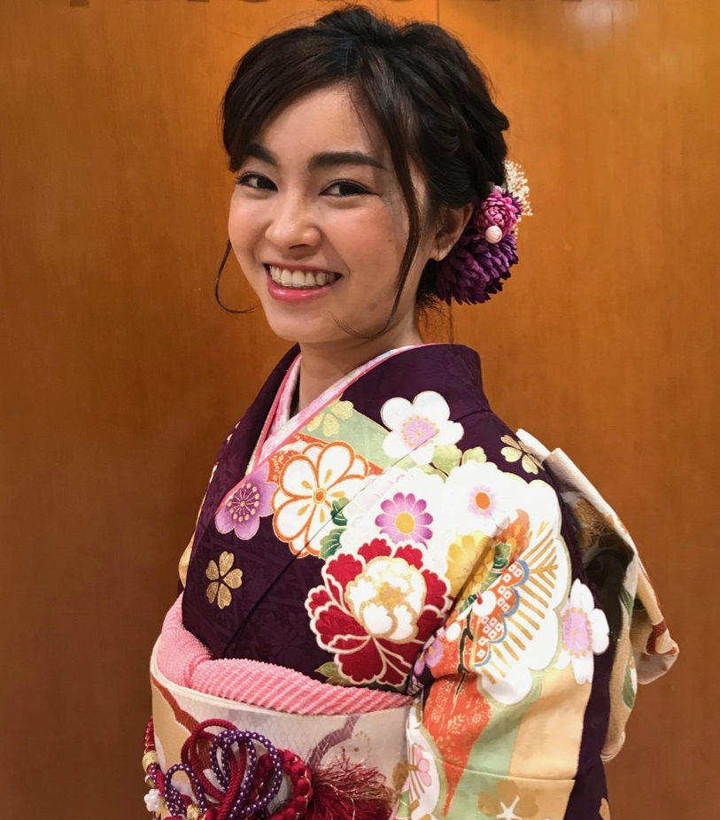

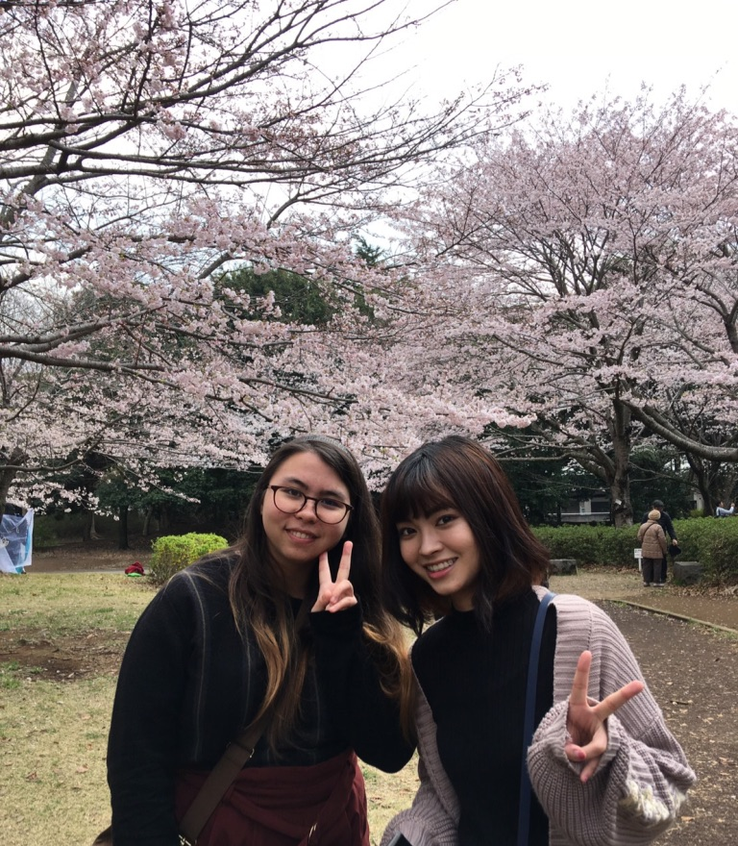
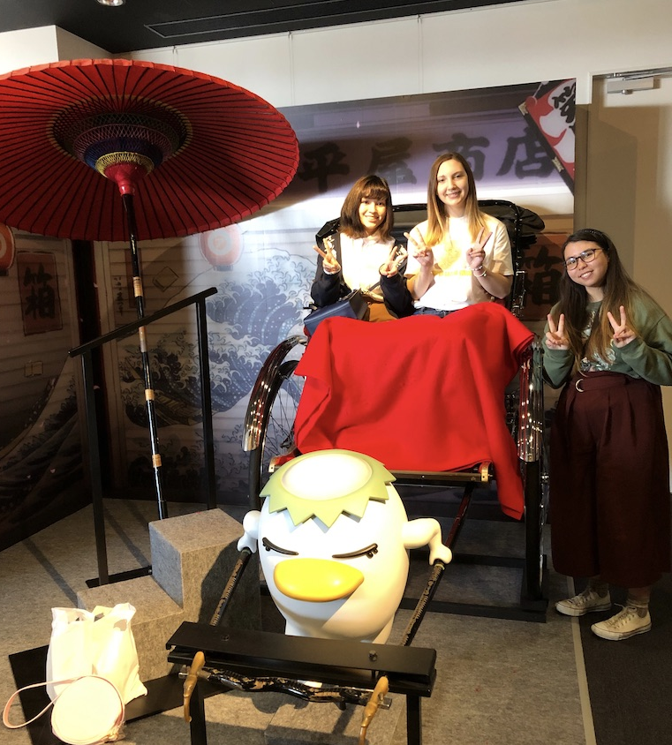
kana
Waseda University – Tokyo, Japan
One word to describe the experience:
Memories
As a Japanese major, I was thrilled to be able to live in Japanese history as it was written. I was able to see the Prime Minister of Japan giving a speech at Akihabara Station, see the reconstruction of Shibuya as it gets ready for the Tokyo Olympics, and even see the Emperor of Japan in the flesh as Japan entered the new Reiwa-era!
Notes:
This is Kana, who studied abroad at Waseda University in Tokyo.

Slide 12
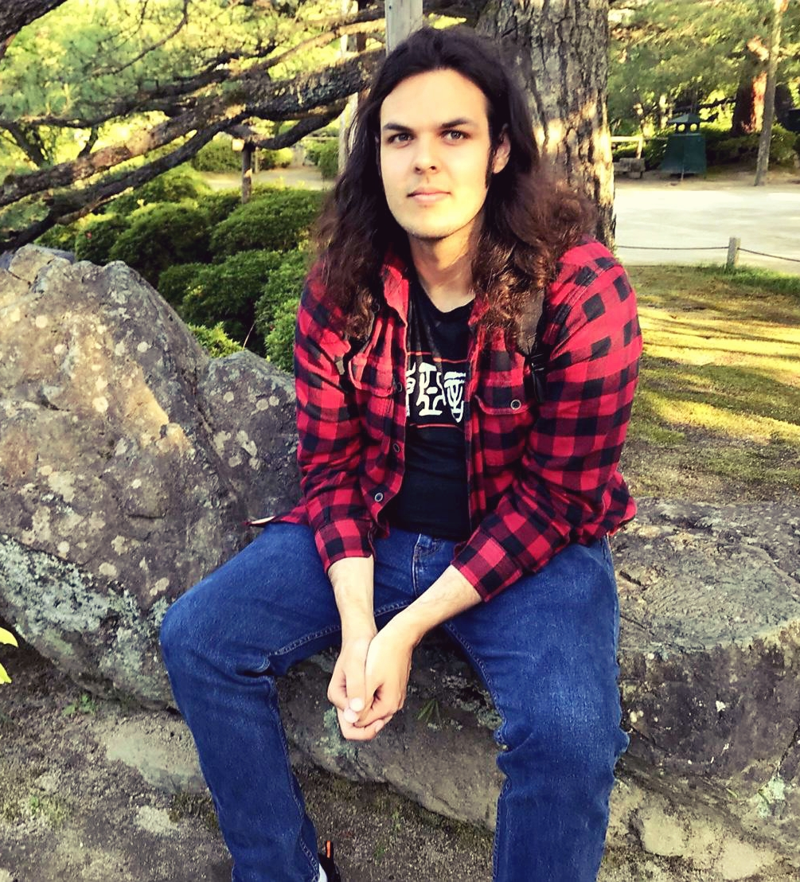
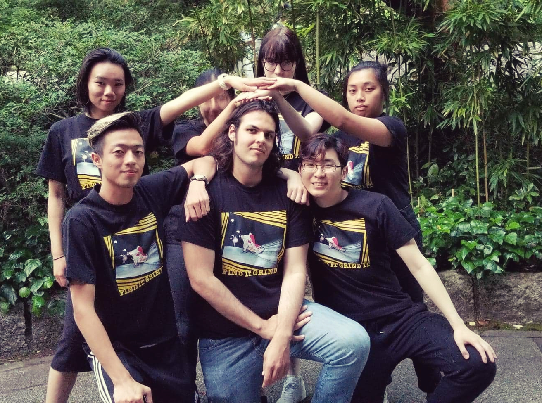
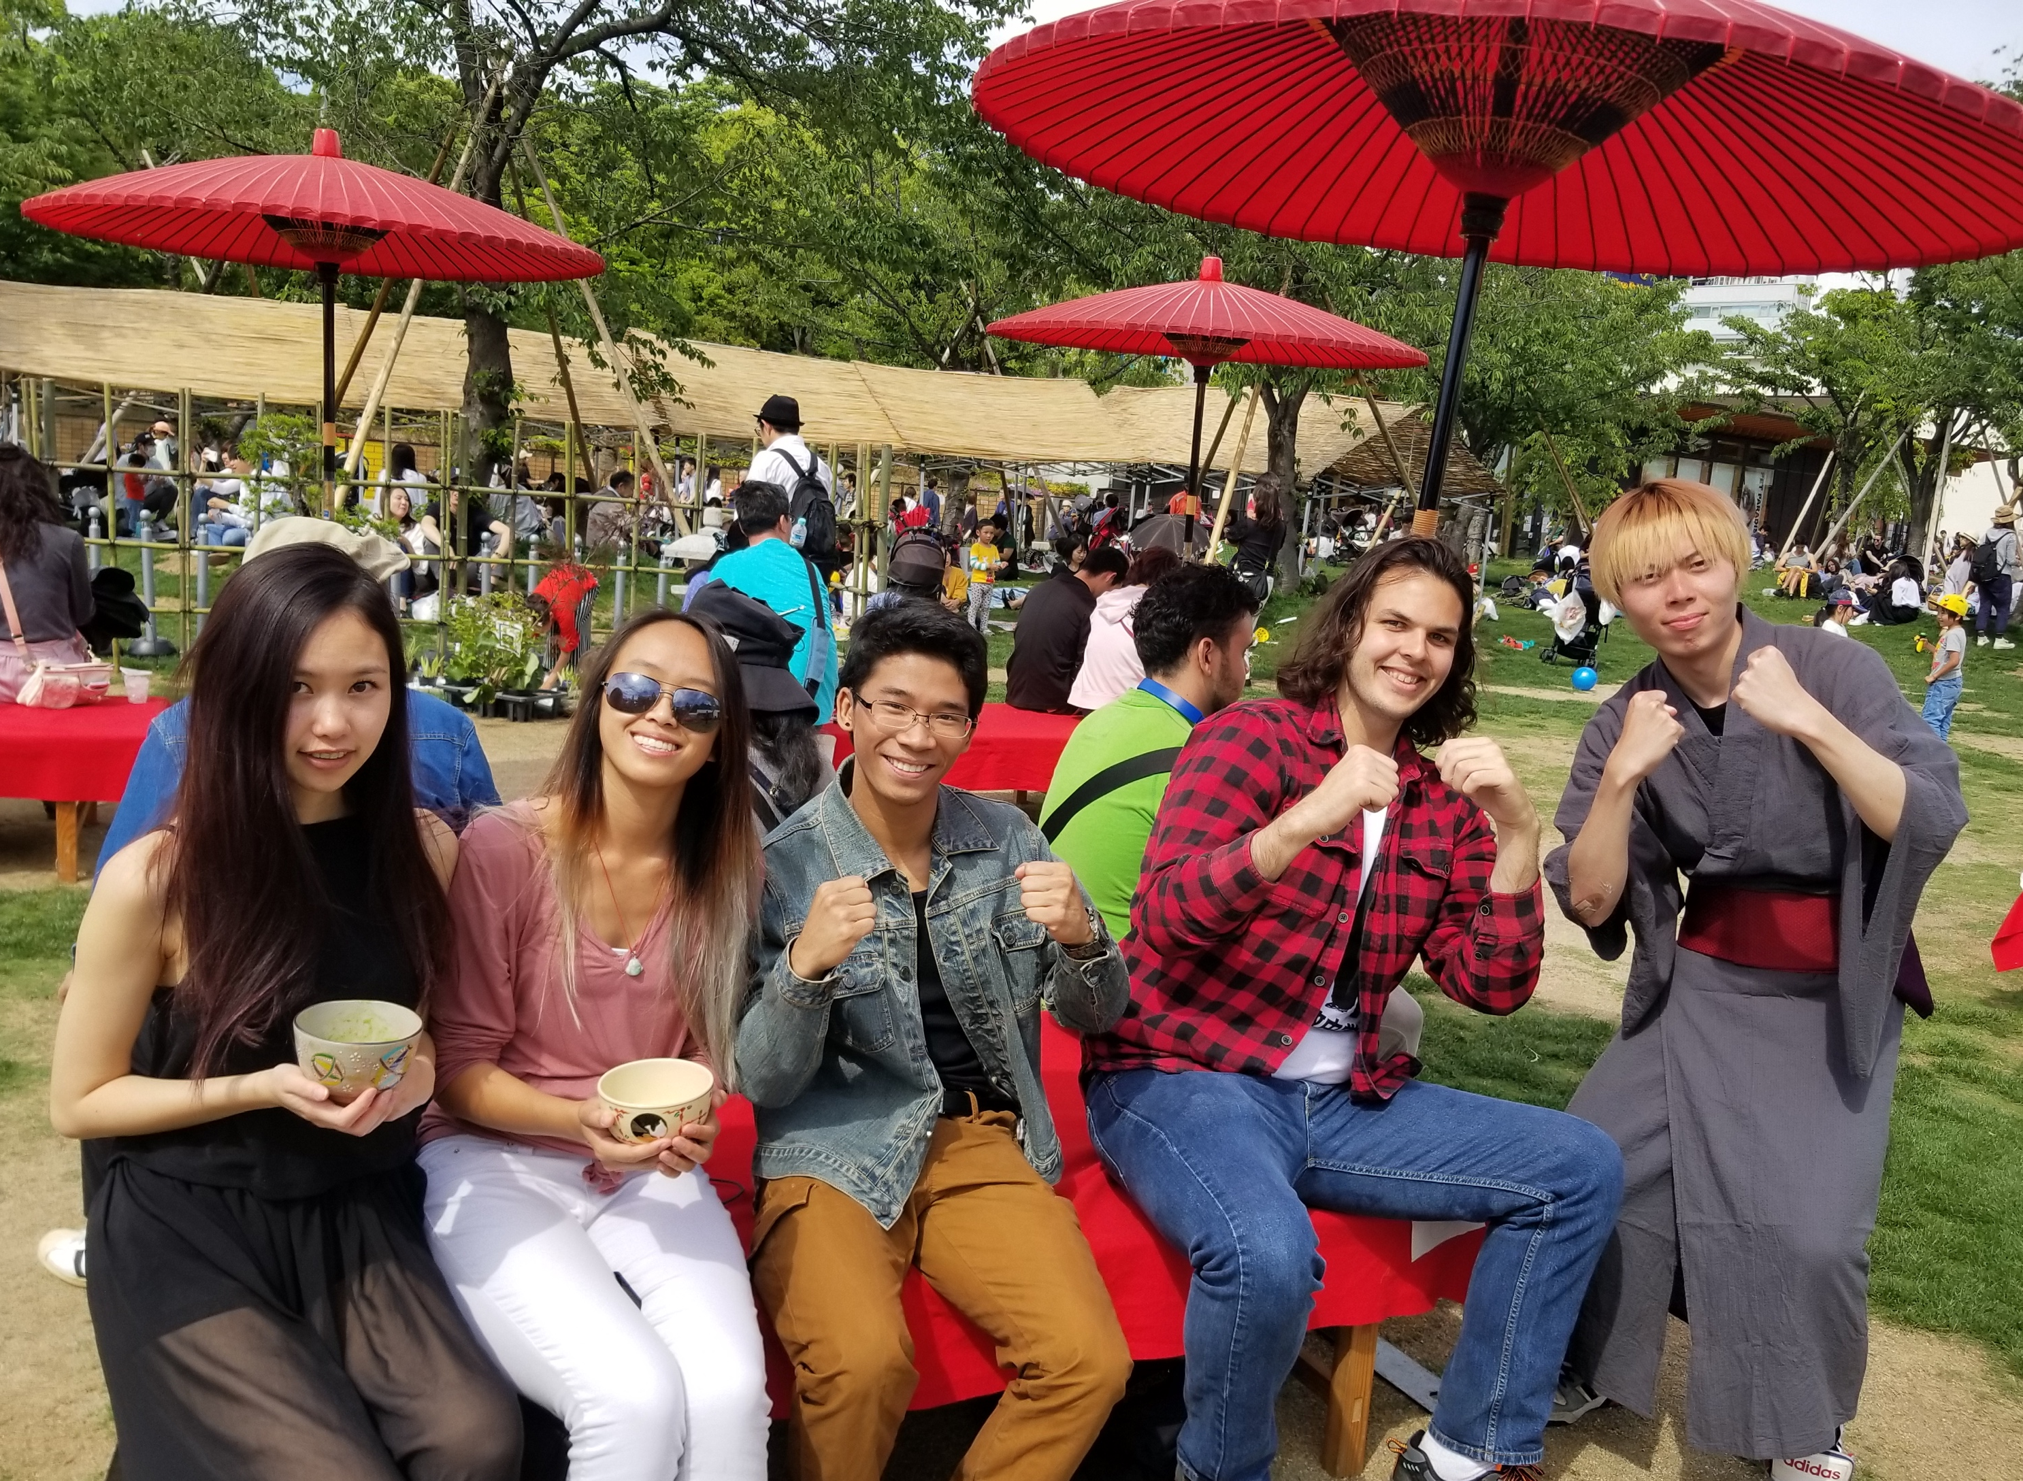
ryan
Kyoto Seika University – Kyoto, Japan
One word to describe the experience:
Fulfilling
Studying abroad didn’t just help me get better at Japanese, though of course it helped with that too. It helped me learn more about who I am as a person and granted me a broader perspective of both myself and of the world we all share. It was a life-changing experience and I would not trade the memories or friends I made on the journey for anything.
Notes:
This is Ryan who studied abroad in Kyoto.

Slide 13
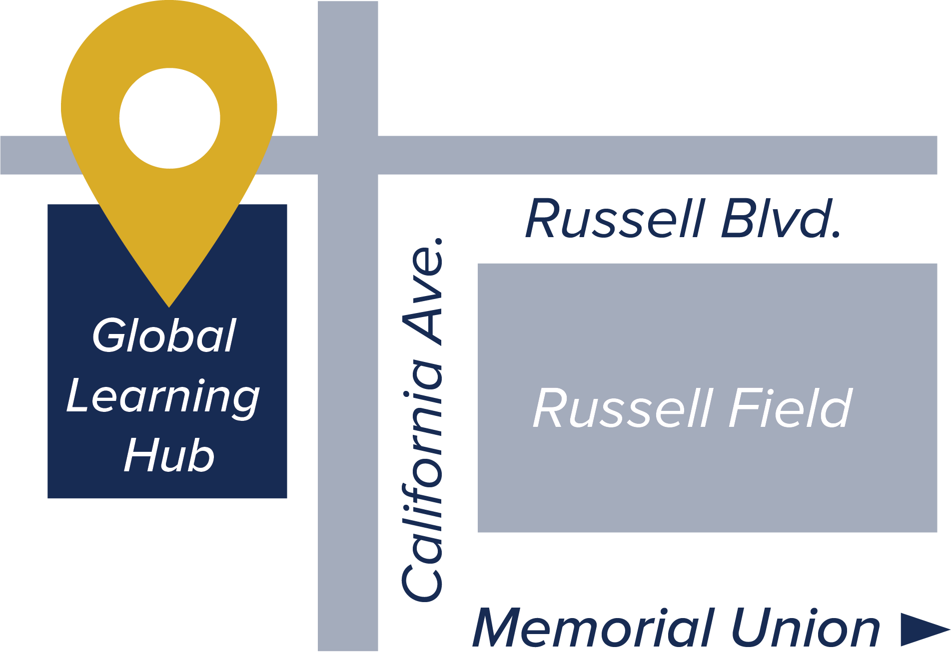
QUESTIONS about studying abroad?
globallearning.ucdavis.edu
Global Learning Hub
UC Davis Global Affairs
International Center, Suite 1120
One Shields Ave, Davis, CA 95616
(530) 752-5763
globallearning@ucdavis.edu
Notes:
If you have questions about study abroad, visit globallearning.ucdavis.edu!

Slide 14

You can still participate in
global learning
even if you don't study abroad!
UC Davis has unique internship opportunities through the
UC Sacramento Center and the Washington Program!
uccs.ucdavis.edu
washingtonprogram.ucdavis.edu
Notes:
If studying abroad isn’t really your cup of tea, there are still endless internship opportunities available to you at UCD. To name a couple, be sure to look into the UC Sacramento Center and Washington Program! These are internships that take place in the capitals of the state and country! You definitely don’t need to be a Political Science major or whatever to participate – there are many humanities and language-based internships available through these programs too.

Slide 15


get involved: language opportunities
TUTORING
Free Chinese and Japanese language tutoring with other fellow UCD students on the first floor of Sproul Hall!
CLUBS
csi.ucdavis.edu
  Chinese Drama Club, Chinese Student Association (CSA), Taiwanese American Organization (TAO), Davis Chinese Dance, Davis Chinese Orchestra
  Japanese Language & Culture Connection (JLCC), Japanese American Student Society (JASS), Kaiwa Hour, Davis Anime Club
Notes:
On campus, there are also other opportunities for you to get involved. Sproul hall offers language tutoring at all levels, and there are many Chinese and Japanese culture clubs that you can join to meet more people and form friendships. Check out csi.ucdavis.edu for a fuller list of the student organizations at UCD.

Slide 16
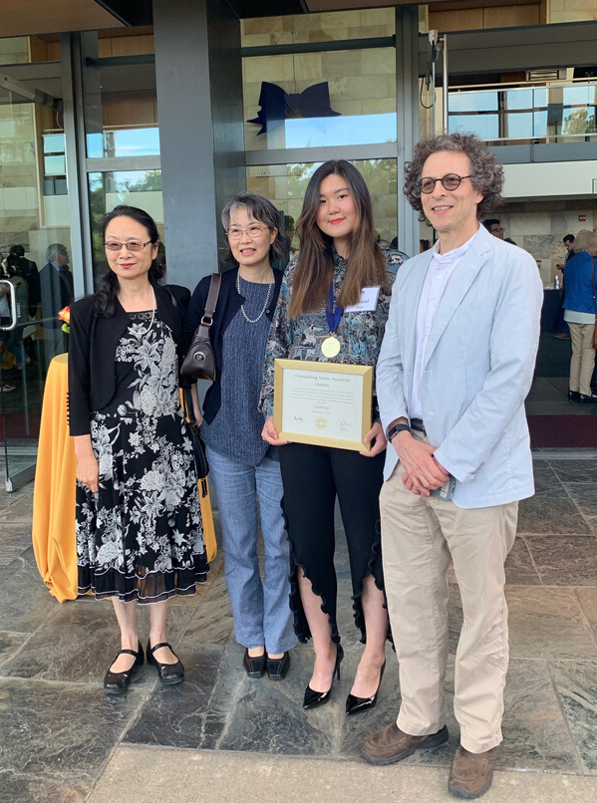
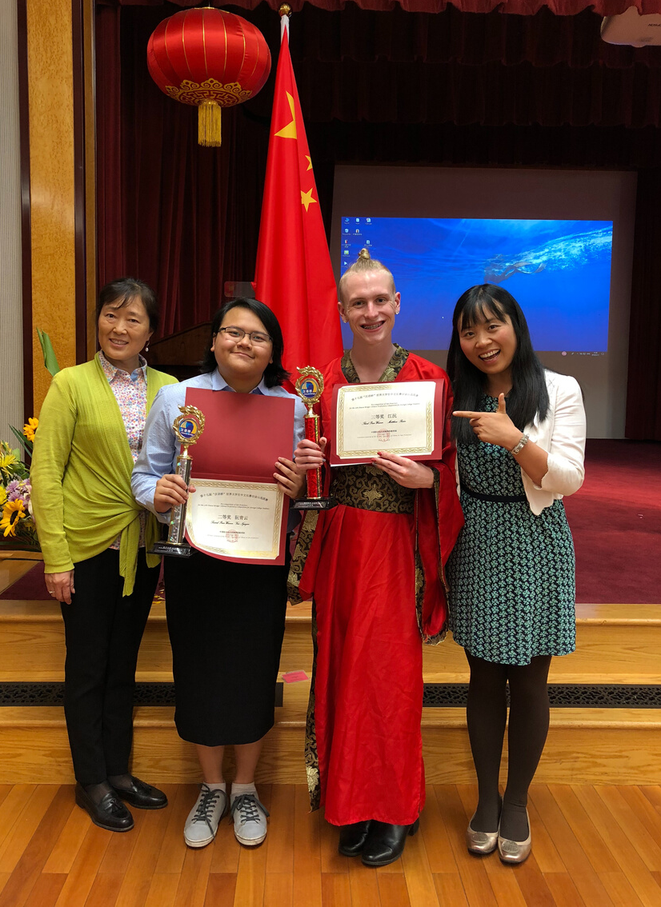
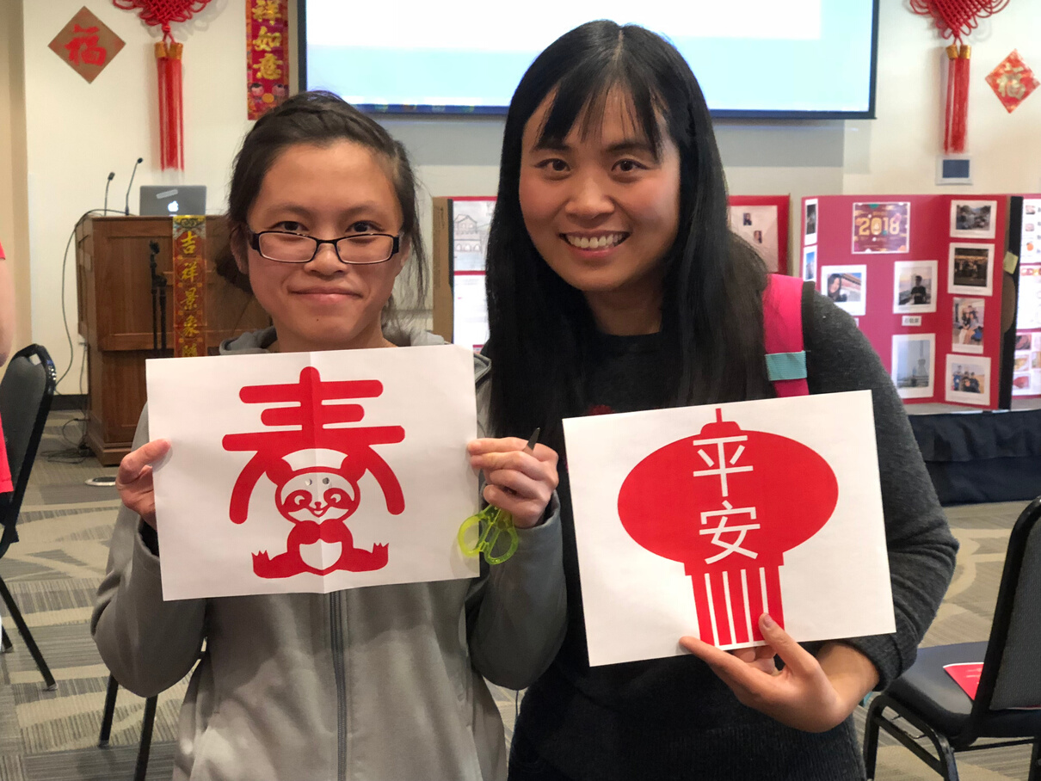
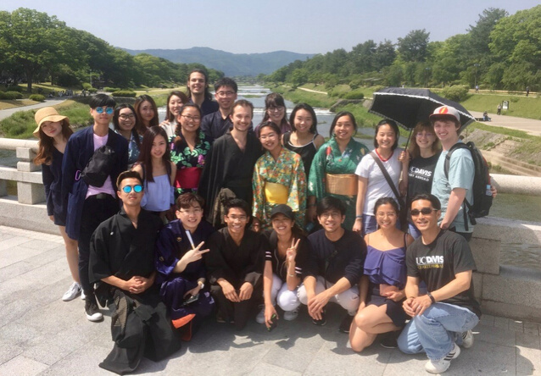
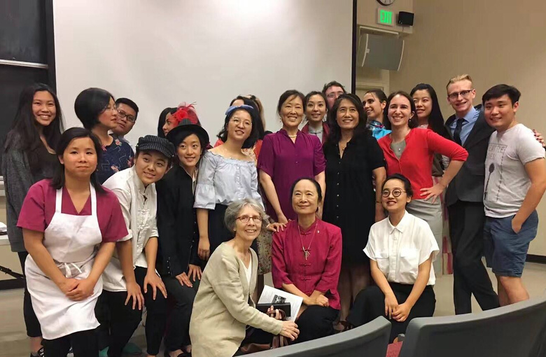
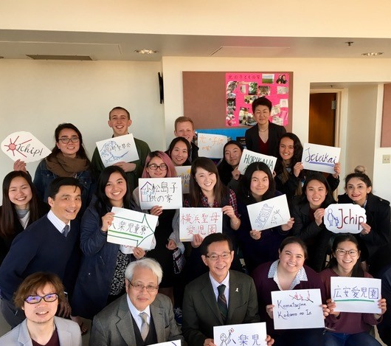
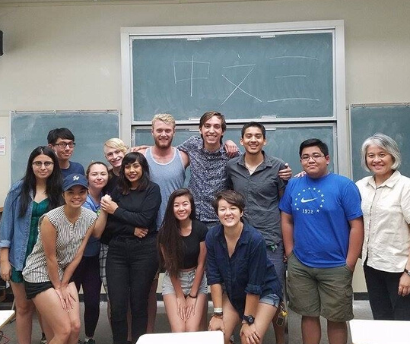
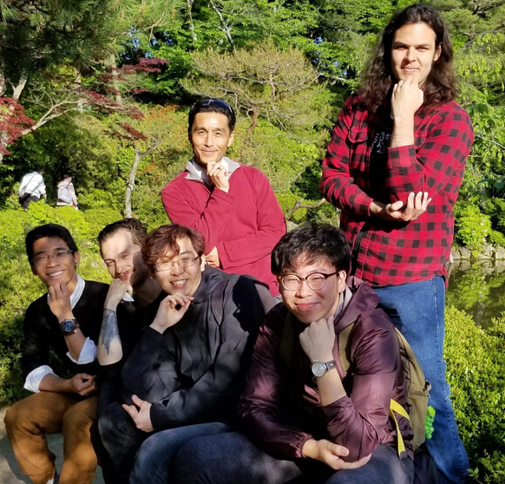
OUR COMMUNITY
Notes:
And lastly, here are some pictures of our EALC community. From award ceremonies, study abroad, and even just in class, the faculty and staff are all here to support you and celebrate your achievements. We look forward to what you will accomplish here in EALC!

Slide 17

Notes:
Also, if are an avid Instagram user, make sure you go follow us @ucdlanglit to stay connected and updated!

Slide 18
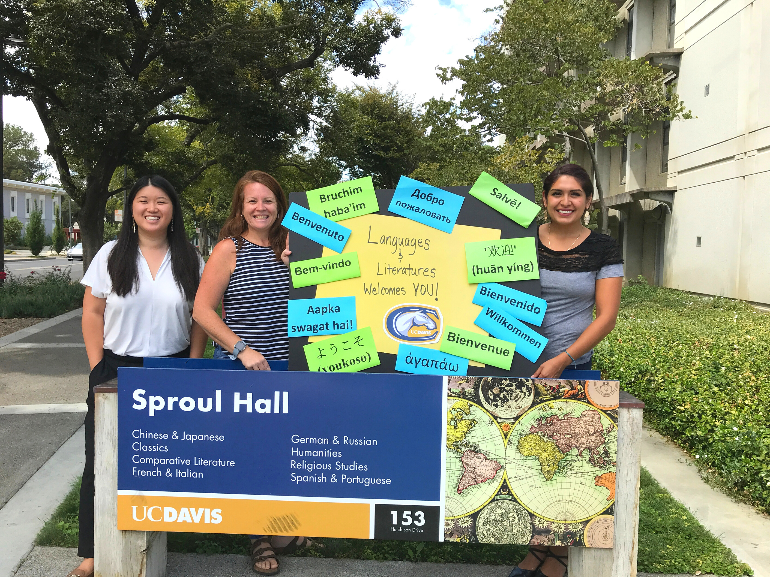

We are excited to meet you!
Notes:
And again, we are excited to meet you!

